Slide 1




Synaptic Theory of Working Memory
AIBC2021
Aohua Cheng
Tsinghua University

Slide 2
Requirements of the presentation (pls delete on your final PPT)
1, Pres 10mins in total, no less than 8 mins, no more than 11mins.
2, Q&A for 5mins
3, Upload your PPT before 8 AM. Aug.21 (strict deadline, otherwise you will lose the chance to present your work) to
https://drive.google.com/drive/folders/1iezWG6GolzoAM0-DbtUdGN26HbWZK6Wt?usp=sharing

Slide 3

Introduction of myself
Aohua Cheng
Your lab : Medicine & Medical Robot Research Center
Your research background :
Medical Robot, Computational neuromorphology,
Memory recall with ANN
Your interests :
Consciousness
Consciousness, Biophysics, ANN

Slide 4
Project background and the scientific question
Working memory
• why do you think it’s an interesting question?
Temporary information for processing purposes, playing a crucial role in cognitive tasks.
delayed-response paradigm
Enhanced, stimulus-specific spiking activity has been observed during the delay period and is considered to be a neuronal correlate of WM.
• Any previous results, either yours or published results (I mean a background survey)?
emerges either from intrinsic cell properties (6, 7) or as persistent reverberations in selective neural populations coding for different memories
holding information in a spiking form is energetically expensive because of the high metabolic cost of action potentials, delay activity increase can be very modest (14, 15), sometimes disappearing completely during part of the delay period
• How to solve?
We therefore propose that an item is maintained in the WM state by short-term synaptic facilitation mediated by increased residual calcium levels at the presynaptic terminals of the neurons that code for this item

Slide 5
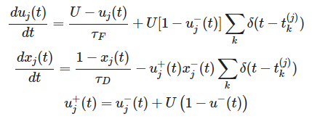
Method
We implemented this mechanism with a recurrent network of LIF neurons. The network encodes a set of memories (items) by randomly composed selective populations of excitatory neurons.
Connections: excitatory-excitatory synapse for the same memory are stronger than connections between different populations, mimicking the result of prior long-term Hebbian learning (25) or intrinsic clustering of recurrent connections. Inhibitory-excitatory synapse in a nonstructured way, resulting in competition between different memories.
Synaptic efficacy is modulated by the amount of available resources (x, normalized so that 0 < x < 1) and the utilization parameter (u) that defines the fraction of resources used by each spike, reflecting the residual calcium level
Upon a spike, ux produce the postsynaptic current, reducing x mimics neurotransmitter depletion, increases u mimics calcium influx into the presynaptic terminal and effects the release probability.

Slide 6
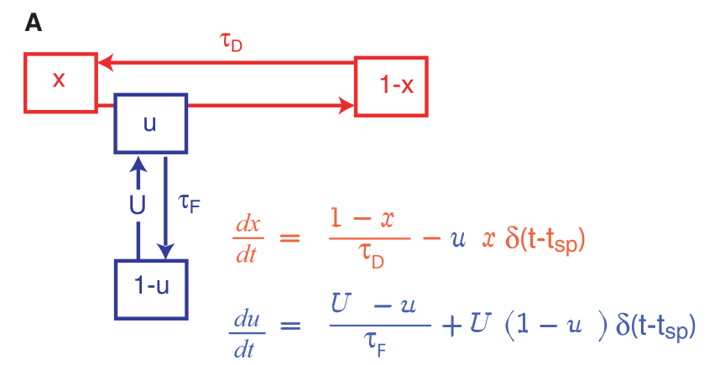




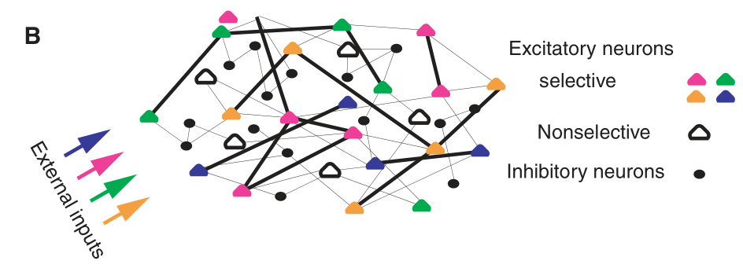
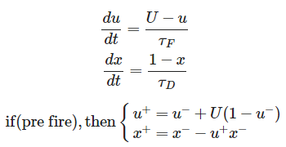
Method

Slide 7
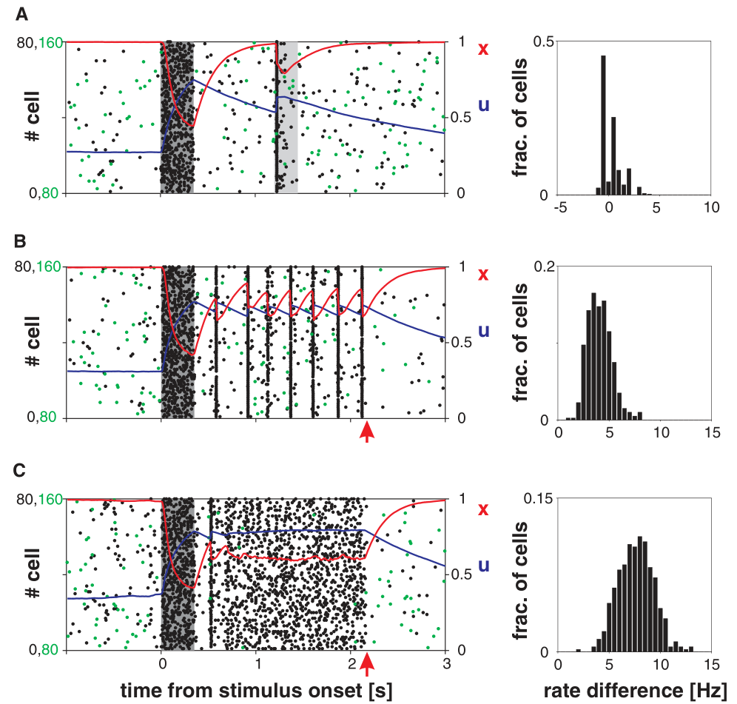
Results
The simulations begin with loading one item into WM by providing transient external excitation to the corresponding neural population.
As long as the synapses remain facilitated, the memory can be reactivated by presenting a weak nonspecific excitatory input to the whole network (gray shading), even though the neural activity is at the spontaneous level. Reactivation is expressed as a short epoch of synchronized activity [“population spike” (PS)], where almost every neuron in the population fires a spike within an interval of about 20 ms

Slide 8
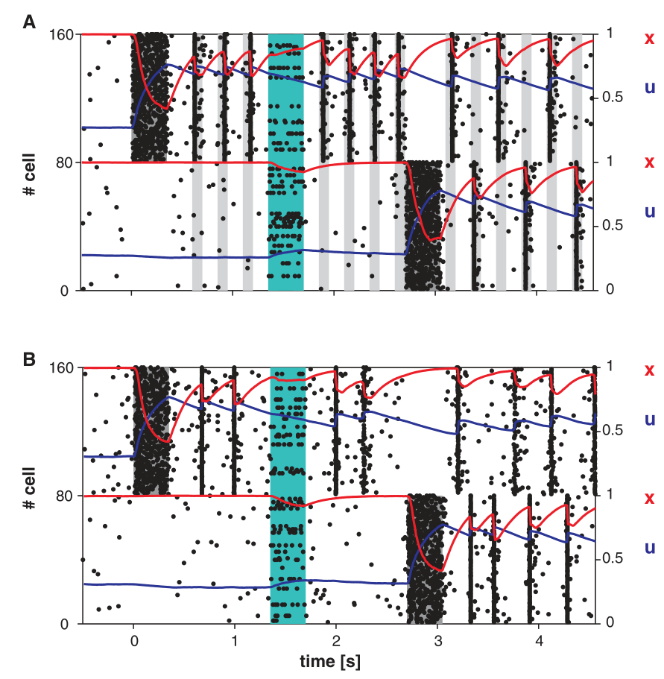
Results
the above network has a single stable activity state corresponding to the spontaneous activity, thus appropriately timed external signals are required to extract the memory from synaptic to spiking form. A more persistent form of WM requires the selective population to exhibit a bistable activity regime, where the spontaneous state coexists with another stable state. Our network can be forced into this regime by increasing spontaneous activity by means of a global nonspecific background input.
In the bistable regime, PSs become persistent without reactivating inputs (Fig3.B)

Slide 9
Discussion

Slide 10
Acknowledgment
Thank Zilong Ji, XiaoLiu, Chaoming Wang’s help for tutorials and project.
Thank Professors for exciting lectures to broaden our horizon of CN and AI.
Thank Prof. Si Wu, Jun Zhang .etc for organizing such a wonderful summer school.
Thank peers for discussing and having a good time here.

Slide 11
Q & A ～5 mins
AI and Brain Computation
August 9 - August 22, 2021

Slide 12
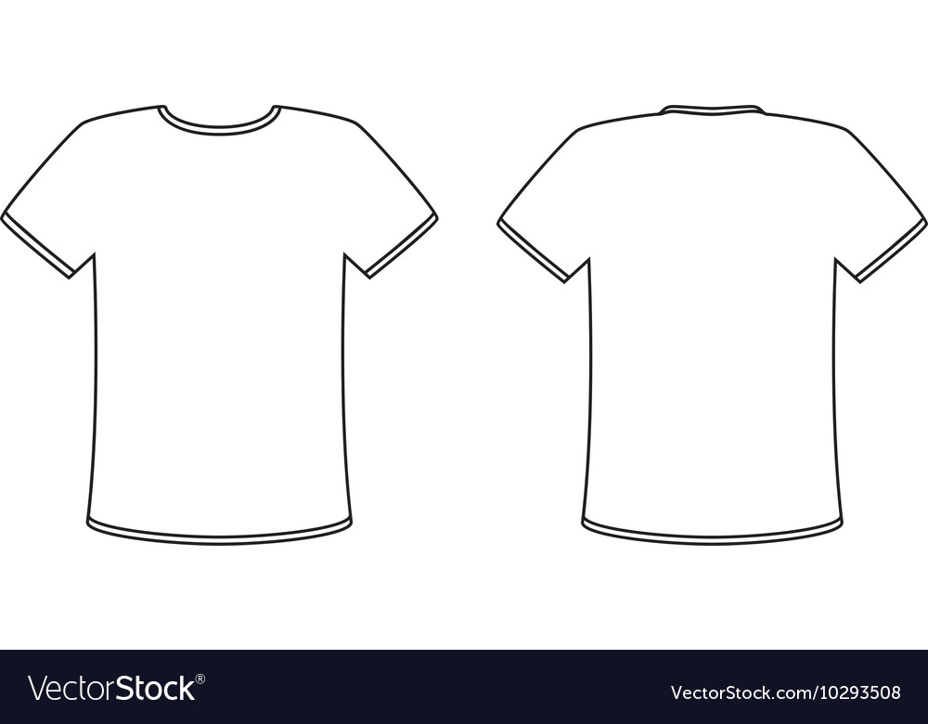
Your T-shirt Design
Memory for our AIBC2021～
Don‘t Quit！
Tips：
1，可以体现AI和Brain Computing的交叉
2，可以体现2021的元素（今年是我们第一届summer school，是元年）
3，可以体现online课程的特殊性
4，可以体现你对AIBC2021的感受
5，...

